Slide 1
A Portrait of Mortality Prediction with NHANES 2003-2006: Morphometrics, Activity, and Metabolic Markers
Karadsheh, M.D.
June 29, 2025
A Data-Driven Exploration of Energy Balance and Longevity
By Proxies:
Activity, Hypertension, Sleep Apnea, Morphometrics, Laboratory Data

Slide 2
Introduction
Objective: Predict all-cause mortality using NHANES 2003-2006 data, focusing on morphometrics, physical activity, and metabolic markers.
Hypothesis: Energy balance (via respiration, activity, and metabolism) drives health outcomes and mortality risk.
Dataset:
  NHANES 2003-2004 & 2005-2006 cycles.
  3,198 participants, 121 variables (demographics, morphometrics, activity, labs, mortality, including 5 year survival).
  Source: CDC NHANES + Leroux et al. (2019) mortality data.

Slide 3
Background
NHANES: Biennial CDC survey assessing health and nutrition in the U.S. population.
Leroux et al. (2019): Accelerometry-derived activity (e.g., Total Activity Counts [TAC]) predicts 5-year mortality better than traditional risk factors.
This Study: Extends analysis by including:
  Sleep apnea probability.
  Morphometrics (e.g., BMI, Waist-to-Height Ratio [WHtR]).
  Metabolic markers (e.g., creatinine, triglycerides).
Focus on respiration and energy balance proxies.

Slide 4
Data Sources & Preprocessing
Data Sources:
  Mortality & Activity: Leroux et al. dataset (3,198 rows, 81 columns).
  Body Measurements (BMX): 19,593 rows, 34 columns (e.g., Weight, Height, BMI).
  Demographics (DEMO): 20,470 rows, 46 columns (e.g., Age, Gender, Race).
  Blood Pressure & Labs: BPX, BPQ, CRP_D, etc.
Preprocessing:
  Merged datasets using participant ID (SEQN).
  Cleaned: Dropped flag/comment columns, imputed missing lab values (median).
  Derived: Waist-to-Height Ratio (WHtR).

Slide 5
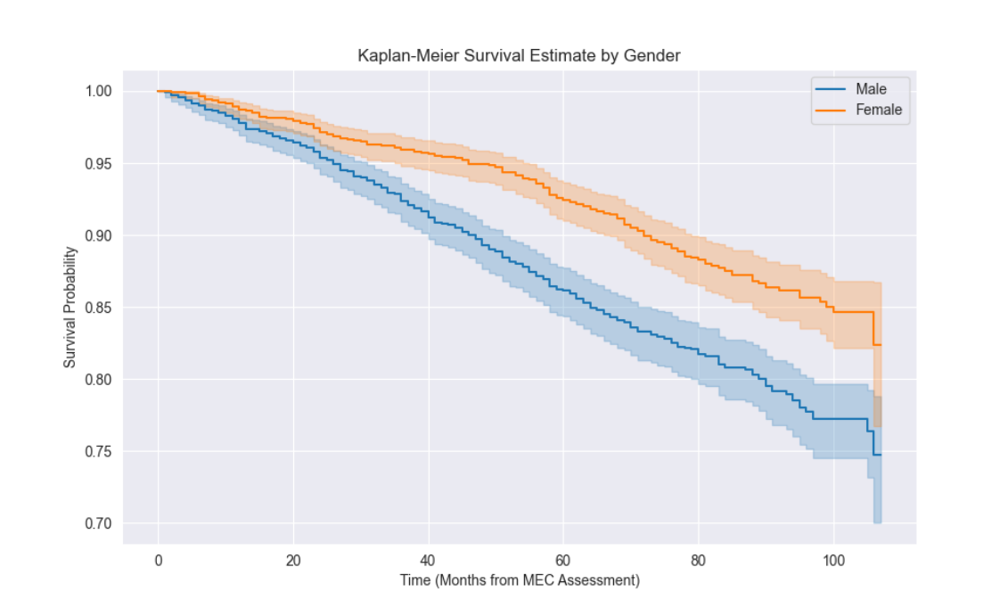
Data Set: Mortality

Slide 6
Exploratory Data Analysis (EDA)
Dataset: NHANES_mort_act_morph_lab_df (3,198 rows, 121 columns).
Key Statistics:
  Mortality rate: 15.6% (500 deceased).
  Mean age: 65.45 years (range 49–84).
  Gender: 50.4% male, 49.6% female.
  Race: 58.2% White, 18.8% Black, 17.9% Mexican American.
Morphometrics:
  Weight: Mean 60.31 kg (2.4–371 kg).
  BMI: Mean 25.37 kg/m² (12.1–81.1 kg/m²).
Missing Data: Significant in age-specific measures (e.g., Head Circumference: 19,032 missing – not used).

Slide 7
Features
Age
Gender
Race
Activity
Hypertension
BMI
Waist To Height Ratio
Obstructive Sleep Apnea Probability (OSA)
Labs: | C-Reactive Protein (CRP): Inflammation
 | Lactate Dehydrogenase (LDH): Metabolism
 | Triglycerides (TG): Metabolism
 | Creatinine (Cr): Kidney Function
 | Uric Acid: Metabolism

Slide 8
Feature Engineering
Selected Features:
  Numeric: Age, TAC (total activity), WHtR_calculated, OSA_Probability, LogCRP, LDH, Triglycerides, Uric acid, Creatinine.
  Categorical: Age_Group, BMI_cat, Race, HTN_Category_Measured.
Processing:
  Categorical variables: One-hot encoded.
  Numeric features: Scaled using StandardScaler.
  Missing lab values: Imputed with median (131–165 'NA' per column).
Focus: Breathing (TAC, WHtR, OSA_Probability) and metabolic stress (labs).

Slide 9
Model Development
Model: Random Forest Classifier with Synthetic Minority Oversampling Technique (SMOTE).
Parameters:
  n_estimators=200, max_depth=20, max_features='sqrt', class_weight='balanced'.
  Random state: 42.
Evaluation:
  80/20 train-test split (2,558 train, 640 test).
  5-fold cross-validation.
  Primary metric: F1-score (focus on deceased class).

Slide 10
Model Performance
SMOTE Model Results:
  Accuracy: 0.80
  Class 0 (Survived):
    Precision: 0.87, Recall: 0.91, F1: 0.88
  Class 1 (Deceased):
    Precision: 0.38, Recall: 0.39, F1: 0.38
  Confusion Matrix:
    True Negatives: 490, False Positives: 50
    False Negatives: 77, True Positives: 39
Cross-Validation: Mean F1-score = 0.20 ± 0.06

Slide 11
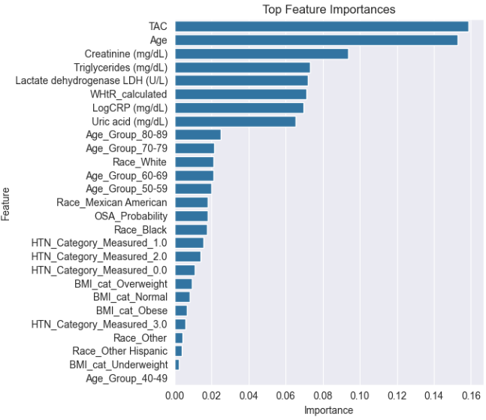
Top Features

Slide 12
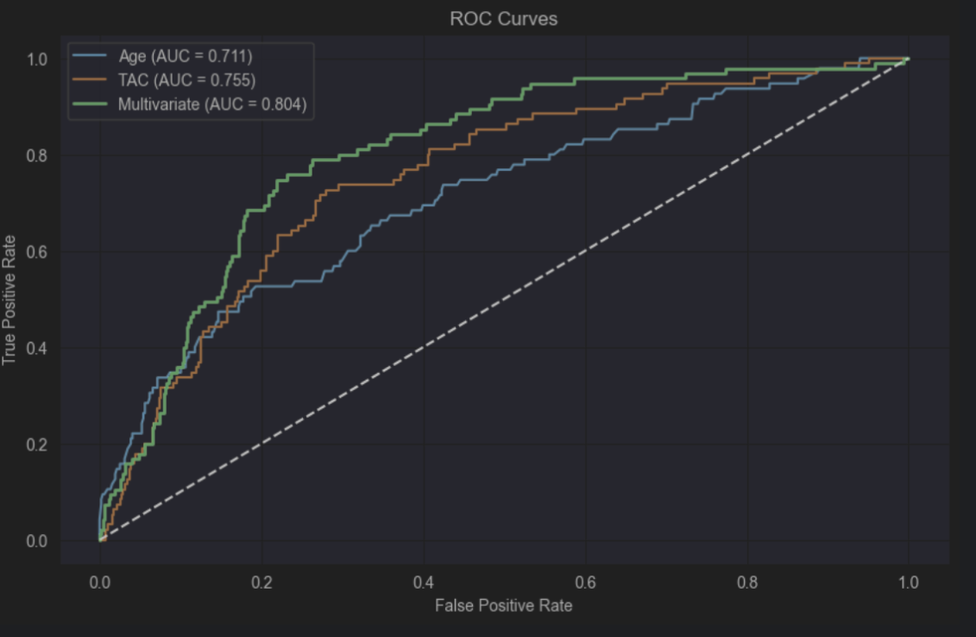
Multivariate vs. TAC
Insight: Multivariate AUC is an improvement over Total Activity (TAC)

Slide 13
Feature Importance
Top Predictors:
  Total Activity Counts (TAC): 0.1588
  Age: 0.1526
  Creatinine: 0.0938
  Triglycerides: 0.0730
  Lactate Dehydrogenase (LDH): 0.0721
  WHtR_calculated: 0.0714
  LogCRP: 0.0696
  Uric acid: 0.0653

Slide 14
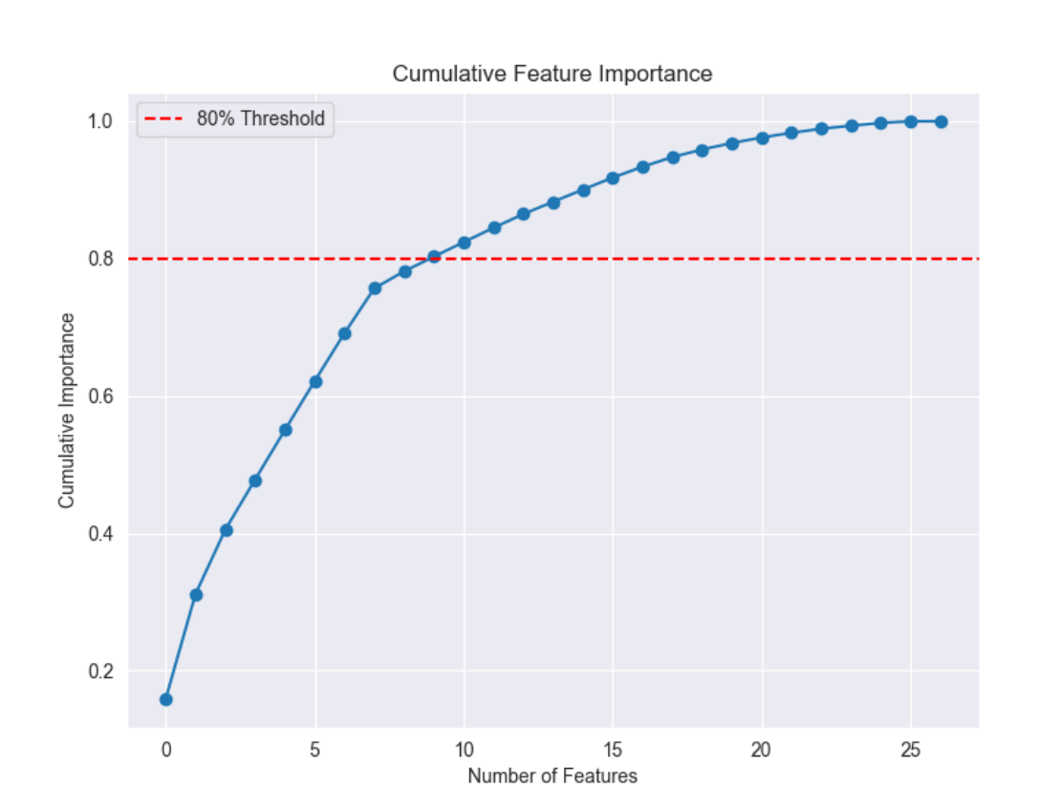
Features Importance
8 Features Exert The Greatest Influence On The Model

Slide 15
Comparison with Baseline
Baseline Model (No SMOTE):
  Accuracy: 0.85
  Class 1 (Deceased) F1: 0.21 (Recall: 0.14, Precision: 0.39)
  True Positives: 14 (vs. 39 with SMOTE)
SMOTE Impact:
  Improved deceased class recall (0.14 → 0.39) and F1 (0.21 → 0.38).
  Trade-off: Lower accuracy (0.85 → 0.80), more false positives (17 → 50).
Conclusion: SMOTE enhances minority class prediction, critical for mortality risk detection.

Slide 16
Discussion
Total Activity Counts (TAC): Strongest predictor (0.1588), aligning with Leroux et al.’s findings on activity’s role in 5-year mortality, emphasizing physical activity’s impact.
Age: High influence (0.1526), consistent with its established role as a mortality risk factor across populations.
Laboratory Markers: Significant contributors include Creatinine (0.0938), Triglycerides (0.0730), LDH (0.0721), LogCRP (0.0696), and Uric acid (0.0653), reflecting metabolic stress and inflammation’s role in longevity.
Waist-to-Height Ratio (WHtR): Notable at 0.0714, suggesting a better proxy for obesity-related risks compared to BMI categories.
Sleep apnea probability: Ranked lower than activity. The day’s balance is more important than the night’s, but both are important.

Slide 17
Discussion
  Detailed Feature Insights
HTN Categories: Ranked impact (0.0247–0.0210 across levels), indicating hypertension’s graded effect on mortality, warranting further exploration of severity thresholds.
BMI Categories: Lower ranking (below top features), highlighting WHtR’s superior association with mortality risk over traditional BMI classifications.
Race: Modest influence (e.g., 0.0210 for White), suggesting demographic factors play a secondary but notable role, possibly due to socioeconomic or genetic variations.

Slide 18
Discussion
Key Finding:
  Low activity (TAC), obesity (WHtR), and metabolic stress (Creatinine, Triglycerides, LDH, CRP) predict mortality.
  Activity during the day rules over sleep apnea probability
  Hypertension and BMI subgroups need a separate analysis. Unexpected results.
  SMOTE improves deceased class detection but introduces variability.
Limitations:
  Low F1-score (0.38 for deceased) and cross-validation score (0.20 ± 0.06) suggest underfitting.
  Study population (age ≥49) limits generalizability. Data is cross sectional with several confounding factors that may bear on the analyses.
  Other features in the NHANES need to be explored (e.g. occupation, dwelling type).

Slide 19
Conclusion
Summary: Random Forest Classifier with SMOTE confirms that breathing insufficiency (TAC, WHtR) and metabolic stress (labs) predict mortality in NHANES 2003-2006 data.
Impact: Provides insights and a portrait of energy balance and longevity, supporting activity-based interventions, sleep apnea treatment, weight management and screening with specific labs.
Next Steps: Enhance model performance, combine features, expand feature set, and apply to broader populations.
Data Availability: Cleaned datasets (NHANES_mort_bmx.csv, nhanes_mortality_activity_morph_labs_2003_2006.csv) ready for further analysis, among others such as medications.

